Slide 1

MISSION POSSIBLE: Graduation and Beyond
BRIDGE Advisement- 9th Grade
Class of 2023

Slide 2
BRIDGE Advisement Topics
Topics included (clicking on topic takes you to start of the section):
Athletics
BRIDGE Law
CARE Project
Dual Enrollment
GAfutures
Georgia Career Information System
Graduation Requirements
HOPE
MYAP Tool, Individual Graduation Plan
Pathways-Advanced Academic, CTAE, Fine Arts, World Language
Honors and Advanced Placement
Paulding Virtual Academy
Tests - SAT/ACT/Accuplacer/ASVAB
Work-Based Learning
YouScience Assessment and Results

Slide 3
BRIDGE Advisement Opportunity Provides Information About….
Current Information and Decisions
Current Decisions Impact Future
Course Requests (MYAP Tool)
Learning About and Selecting 10th Grade Courses
BRIDGE Advisement
Planning and Finalizing Course Selections by Gaining Expert Advice
Career Portfolio Information Including Exploration of 3 Careers
Updating the Individual Graduation Plan in Infinite Campus utilizing the MYAP Career Planner

Slide 4


Purpose of Completed
Classroom Guidance
BRIDGE Graduation Plan Reviewed and updated using the MYAP Course Plan Tool:
    Planned Course Requests and Review of Transcript History
    MYAP Progress Tab
Plan for two years beyond high school
    Career Interest Inventory Information
    Exploring 3 careers information
    Use of GCIS site and updating the IGP (Individual Graduation Plan from the BRIDGE Graduation Plan)

Slide 5
Important facts to remember:
For promotion to the next grade level
  Students now progress based on the Cohort Year
    Grade 10 = 2nd cohort year
    Grade 11 = 3rd cohort year
    Grade 12 = 4th cohort year
    Then, at least five (5) credits must be earned to be considered a sophomore.
    Eleven (11) credits must be earned to be a junior.
    Seventeen (17) credits must be earned to be a Senior.
Pass all courses….The transcript includes grades and credits earned for first semester of this school year.
All grades count toward the overall GPA (Grade Point Average) and earning credits for graduation!
All academic courses and grades count for the HOPE eligible grade point average.

Slide 6
What about Attendance?
Coming to school is very important. Missing important instruction can make learning difficult.
Being absent from a block class is equivalent to missing 2 days of a traditional class!

Slide 7
Earning A High School Diploma and Making Plans After High School
      BRIDGE Advisement Individual Graduation Plan

Slide 8
For Next Year and As the Advisement information is reviewed please consider:
Rigorous/relevant courses
  Honors classes add 5 points for students who pass, for local purposes only. Honors courses do not count for the HOPE eligible 4.0 GPA weight.
  AP classes add 10 points for students who pass.
  AP courses passed with a 70 or higher do add a .5 on the HOPE GPA for each AP course (HOPE eligible GPA weight).
  Dual Enrollment courses in core areas of English, Math, Science and Social Studies add 10 points to the numeric GPA locally and .5 on the 4.0 HOPE GPA
Study Skills
Organizational Skills

Slide 9
One Diploma Type
Graduation Requirements
Areas of Study: Units Required
English/Language Arts * 4
Mathematics* 4
Science* 4
Social Studies* 3
CTAE and/or Fine Arts and/or World Lang. 3
Health and Physical Education* 1
Electives 4
Total Units (Minimum)
* Required Courses and/or Core Courses
23
Notes:
Under the new rule, all students will be required to complete a common set of requirements, as listed here. Tiered diploma options (College Preparatory with Distinction, College Preparatory, Technology Career with Distinction, and Technology Career) will be eliminated.
9

Slide 10

Our advisement assists students with….
Who am I?
Where am I going?
How do I get there?

Slide 11
BRIDGE Individual Graduation Plan
Students use the Multi-Year Academic Planning tool in IC.

Slide 12
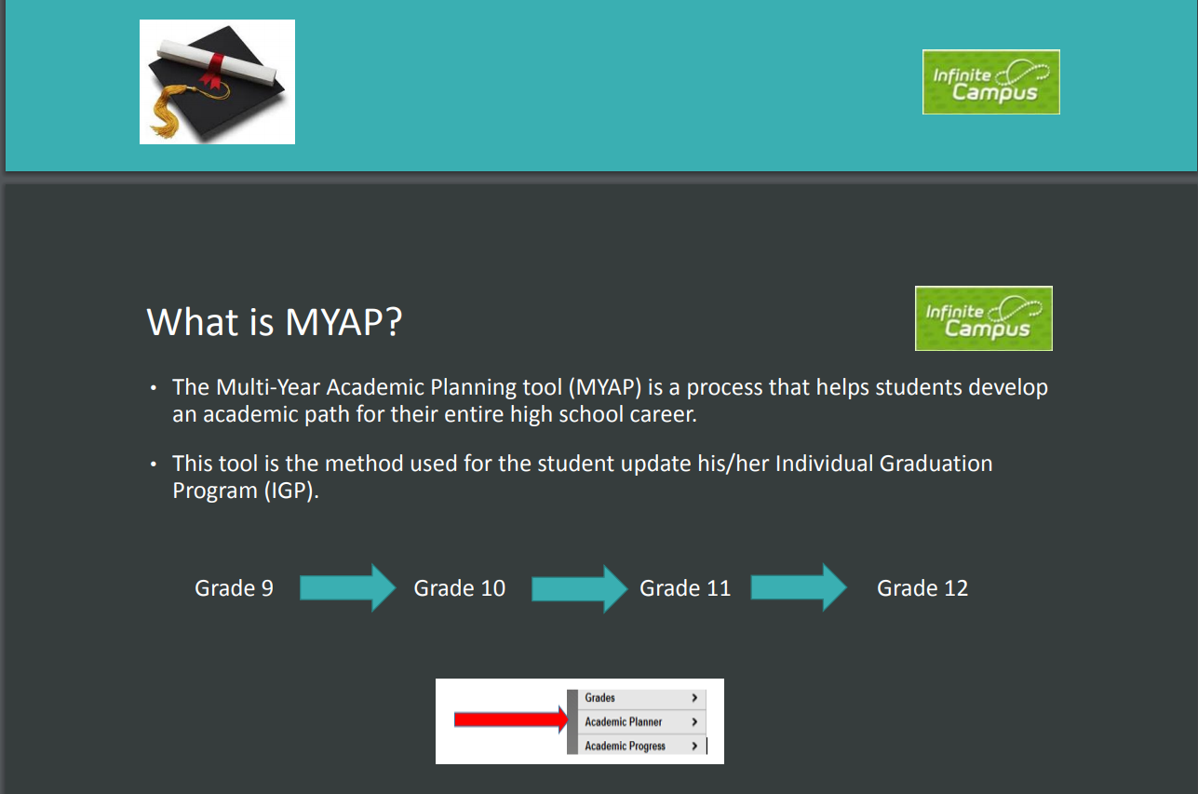

Slide 13
MYAP Career Planner
All high school students use the IC MYAP Career Planner
The IGP (Individual Graduation Plan) is in the IC Student Portal
This information includes completed, scheduled, and planned courses
Use this link for information:
https://www.paulding.k12.ga.us/Page/38561

Slide 14
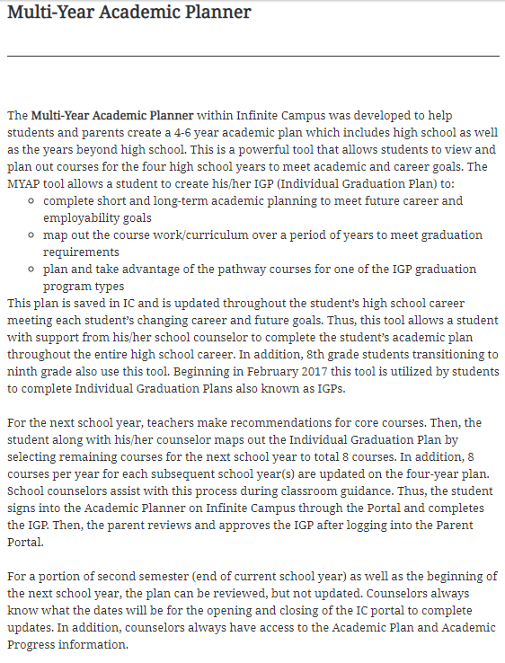

Slide 15
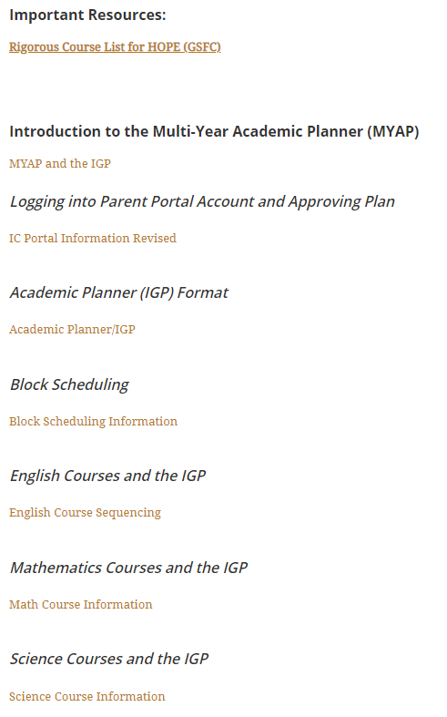

Slide 16
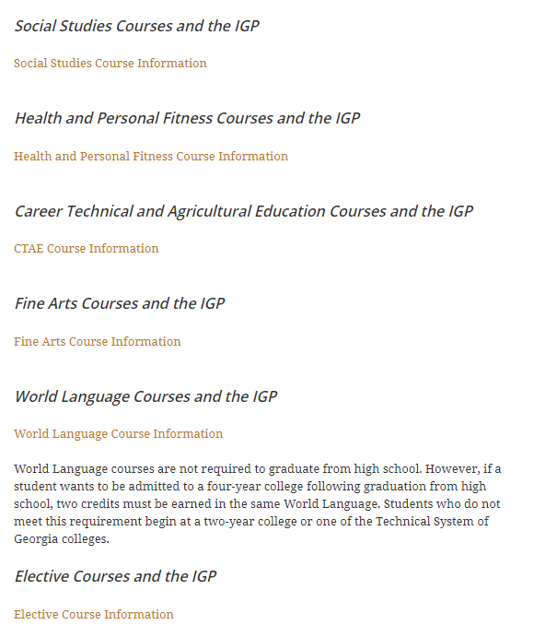

Slide 17

Career Planner Website Link https://www.paulding.k12.ga.us/Page/38558

Slide 18

The AP (Advanced Placement) and Honors Application Process
The IC MYAP planning process will be used to request AP and/or Honors courses for next year.

Slide 19
How are Advanced Placement/Honors classes beneficial to the student’s GPA?
Honors courses are weighted. With successful completion of the course, an average of 70 or above BEFORE weights are added, earns a student five (5) points onto the final course average.
For example: Student earns an 80 in Honors American Literature – the report card and transcript will reflect an 85 as the weighted points are added to the final average.
Advanced Placement courses add 10 points to the final grade, if a 70 or above has been earned.)

Slide 20
What 11th Grade Honors and AP classes are available?
Honors English Literature
AP English Literature
AP Statistics
AP Calculus
Honors Physics
AP Physics
AP Environmental Science
AP Biology
AP Macroeconomics
AP American Government
AP Psychology
AP Studio Art
Honors Spanish III, IV or AP
Honors French III

Slide 21
Plan of Study
Being a Pathway Completer
All students are strongly encouraged to select a Plan of Study/Pathway and complete a sequence of 3 courses in one of the following areas:
  CTAE
  Advanced Academics
  Fine Arts
  World Language
Georgia DOE Plans of Study Website Link for all Plans of Study:
http://www.gadoe.org/Curriculum-Instruction-and-Assessment/CTAE/Pages/Georgia-Career-Pathways-New-Rule.aspx

Slide 22
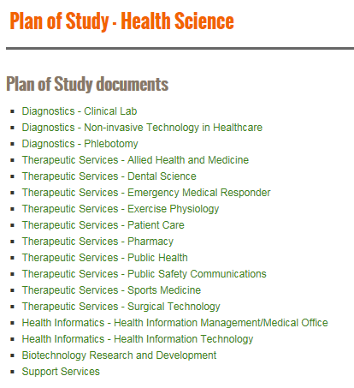
Example Health Science
Plans of Study for Each Pathway

Slide 23
Career Pathways in CTAE
Career Clusters and their Pathways are part of a state supported curriculum that encourages and supports students and families in their educational and career planning through long-term goals, knowledge, experience and resources.
Students may earn three (3) units of credit in a sequence of CTAE courses in a Pathway. These self-selected Pathways lead to college readiness and a career readiness certificate.
There is a Career Pathway Assessment given at the end of the three (3) sequential Career Pathway courses (usually in the Jr. or Sr. year).
Students may use their required Electives courses to complete more than one Pathway during their high school career.
Slide 21

Slide 24
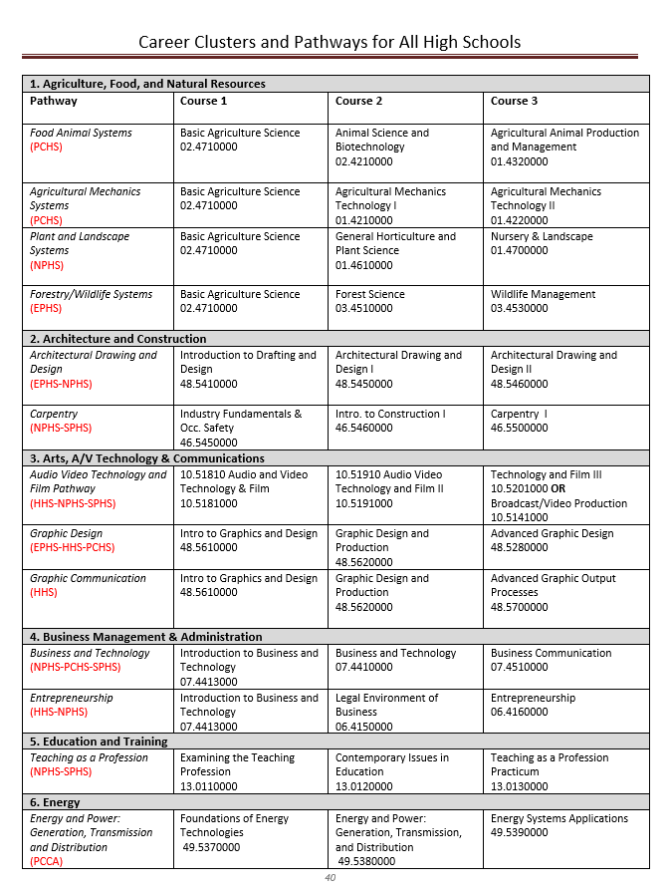
Clusters and Pathway Course Offerings
These vary from HS to HS.

Slide 25
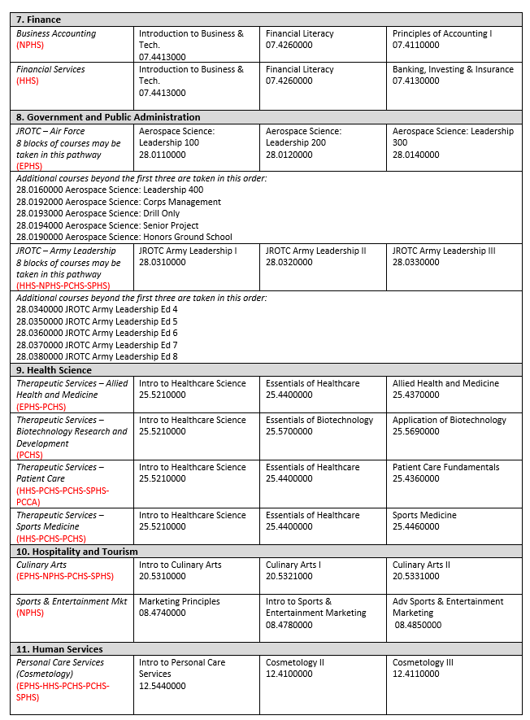
Cluster and Pathway Courses Continued

Slide 26
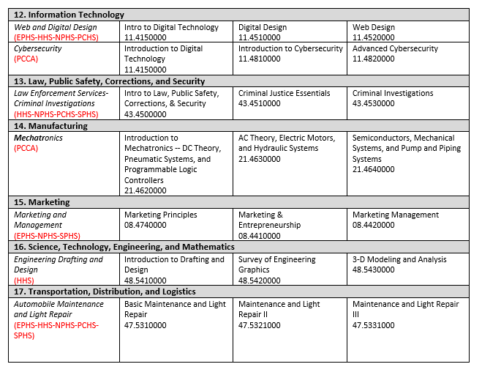
Cluster and Pathway Courses Continued

Slide 27
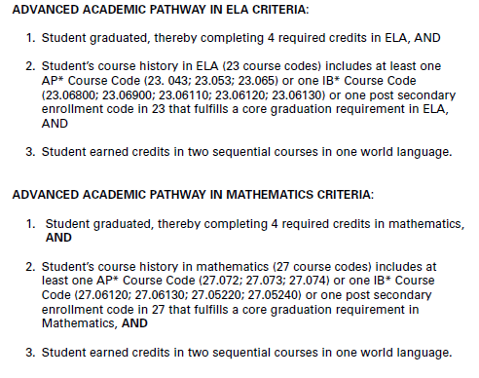
Advanced Academics
Advanced Academic Plan of Study/Pathway
Some students opt to take rigorous courses in the area of English, Mathematics, Science or Social Studies.
Criteria for English and Mathematics are:
Slide 22

Slide 28
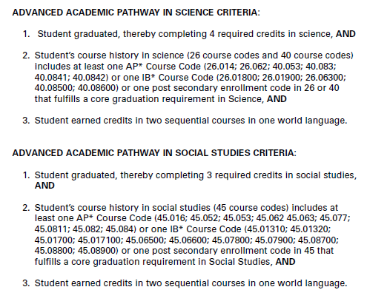
Advanced Academics
Slide 22

Slide 29
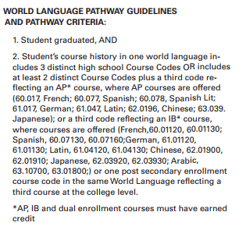
Advanced Academics
Slide 22

Slide 30
Fine Arts Courses
If Band, Chorus, Drama, and/or Visual Arts are courses that you enjoy, these courses can count as “Fine Arts” credit or as regular elective credit. Three courses will complete a Fine Arts Pathway.
Once a student has earned the three units required for CTAE/World Language/Fine Arts, the remaining courses will count toward the required Elective credits.
Slide 22

Slide 31
World Language Courses
Taking a World Language course is NOT required for graduation, but students who wish to gain admission to a college/university must complete two (2) units of the same World (foreign) Language.
Like CTAE and Fine Arts, students may be a pathway completer if 3 sequential World Language courses are completed.
Slide 23

Slide 32
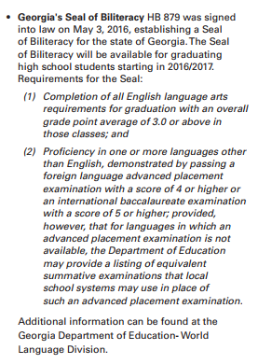
Diploma Seals to Consider

Slide 33
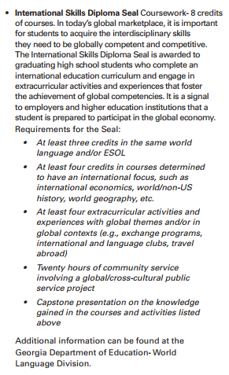
Diploma Seals to Consider

Slide 34
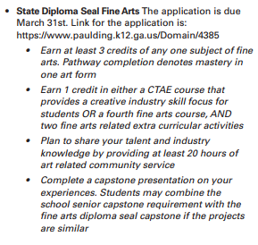
Diploma Seals to Consider

Slide 35
Embedded Course
Essentials of Healthcare, course number 25.44000.
Essentials of Healthcare course now meets the fourth science requirement for high school graduation and meets the fourth science requirement for admission to the University System of Georgia and the Technical College System of Georgia.
If one unit of credit is earned in Essentials of Healthcare, then, student will also receive one unit of credit for Human Anatomy and Physiology, course number 26.07300
Both courses count for HOPE
The EC Human Anatomy and Physiology course will be categorized as an Elective on the local high school transcript.

Slide 36

What if I wanted to take a course Online during high school?
During the months of April – Mid-July 2019, there will be a PCSD online registration opportunity for high school courses.
Senate Bill 289 allows Georgia districts to provide students in grades 3 through 12 the option of taking an online course should you choose that option.

Slide 37
What if I wanted to take a course Online during high school?
Counselors have the online course information for high school courses. The district resource for new credit courses is called Canvas.

Slide 38

Paulding Virtual Academy
Application Windows Begin:
November 1, 2018-2nd Semester
April 1, 2019 for Fall FY20 https://www.paulding.k12.ga.us/Page/29099#calendar74786/20181115/month

Slide 39

What is the Paulding Virtual Academy?
The Paulding Virtual Academy offers students the opportunity to use teacher supported, technology-based courses to earn new high school credit, recover credit, continue coursework or accelerate their progression through high school and into college level courses.
Once again the application process for Fall 2019-2020 begins April 1.

Slide 40


Slide 41

What is the Paulding College and Career Academy?
PCCA opens the Fall semester of 2019
Students who attend PCCA graduate with a high school diploma plus have:
  Dual Enrollment Course Opportunities
  Work-Based Learning/Apprenticeship Program Courses
  Complete a CTAE Pathway and related courses

Slide 42

Pathways offered at PCCA
Career Clusters and their Pathways are part of a state supported curriculum that encourages and supports students and families in their educational and career planning through long-term goals, knowledge, experience and resources.
Students may earn three (3) units of credit in a sequence of CTAE courses in a Pathway. These self-selected Pathways lead to college readiness and a career readiness certificate.
There is a Career Pathway Assessment given at the end of the three (3) sequential Career Pathway courses (usually in the Jr. or Sr. year).
Students may use their required Electives courses to complete more than one Pathway during their high school career.

Slide 43

Regional Partnership for a 5th Pathway

Slide 44
HVACR Electrical Pathway PCCA
Courses (all three) are Dual Enrollment Pathway Courses
Courses are taught at the Bartow County College and Career Academy in Cartersville

Slide 45
Application
Application with minimum requirements will be sent to schools and posted on the district and PCCA website in December.
If student is interested in any of the Career Pathways offered at PCCA, ask about this opportunity with the school counselor and let him/her know about this interest as the Individual Graduation Plan is finalized.

Slide 46

Credit Recovery Courses
(Recommended by School Counselor)
If there is a need to take a credit recovery course due to failing a course, the counselor can help determine if this option is a good choice.
Credit recovery courses are taken via the online resource platform that is offered to district students. That resource will likely be Canvas for next school year. There is an approval process for taking these online credit recovery courses.

Slide 47
CAPSTONE PROJECT
When you are a Senior, you will need to complete a Capstone Project or be involved with Work-Based Learning.
Thinking about a career choice that you would like to research and present is important.
This project will be based on your career interest, so begin thinking about your career interest area(s) as you finish this year and move into 10th and 11th grades.
Students will complete the Youscience Career Assessment in grade 10.
Slide 26

Slide 48
HOPE Scholarship
Currently, the HOPE scholarship is determined by the calculation of all academic core courses that the student has taken and completed (grades 9-12). Class of 2022 students need four (4) additional “rigorous” academic courses to qualify for the HOPE Scholarship.
Courses taken during middle school do not count
Both passing and failing grades in the core courses count
Changes in the eligibility guidelines are posted and updated on the GAfutures website (There are often annual changes in HOPE Scholarship regulations.)
Note Information pages in High School 101 guide as well as Career Planner.
Remember to monitor your HOPE GPA throughout high school via your My GAfutures account.
Slide 30

Slide 49

HOPE Scholarship
(4 Rigorous Courses Required)
Currently, the HOPE scholarship is determined by the calculation of all academic core courses that the student has taken and completed (grades 9-12). No middle school core course grades count.
Georgia Student Finance Commission Rigorous Course Chart
https://www.gafutures.org/media/113414/rigor-course-list-july-2016.pdf
Both passing and failing grades in the core courses count. Thus, this is a merit based scholarship for eligible students.
Changes in the eligibility guidelines are posted and updated on the GAfutures website (there are often annual changes in HOPE Scholarship regulations). For current HOPE tuition payments use this link:
http://gsfc.georgia.gov/tuition-award-charts

Slide 50




Career Decisions
As courses are considered during the advisement and course request process, students need to ask themselves:
What are the courses that I have successfully
completed during my first semester?
What kinds of classes really interest me?
Do I see in my future differently than I did during advisement last year:
  technical college
  college/university
  military
  work
  other

Slide 51
Career Pathway
By now you should be more familiar with an Area of Focus or Career Pathway that you wish to complete. There are 4 areas of focus:
  CTAE
  Fine Arts
  World Language
  Advanced Academics-This pathway has been added as another option for you to consider.
Slide 33

Slide 52
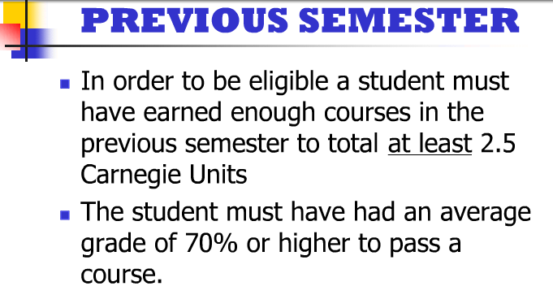

Athletic Eligibility
Georgia Student High School Athletic Association Eligibility
Students must be on track in the senior year, 17 credits earned.
NCAA Information-two links:
https://www.paulding.k12.ga.us/Page/678

Slide 53
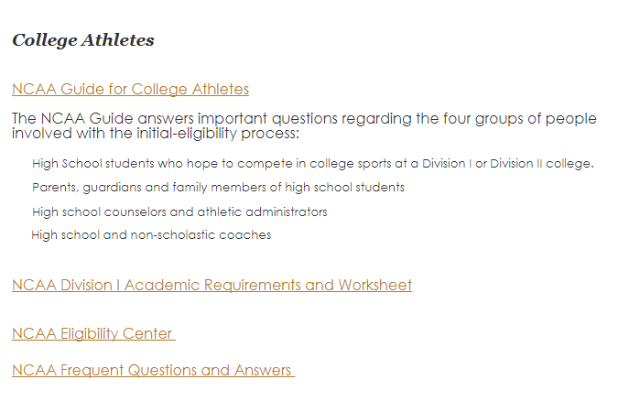
NCAA Information
NCAA Information Links on Counseling Information site:
https://www.paulding.k12.ga.us/Page/678

Slide 54

Important Website www.GAfutures.org
GAfutures (MyGAfutures Account)
  MyGAfutures GPA HOPE information
  College Applications in Georgia
  Scholarships
  FAFSA and Financial Aid
  Financial Literacy
  Dual Enrollment Application
  to Georgia Student Finance
  Commission

Slide 55
Dual Enrollment Defined
A process by which high school students take courses from a state public or private postsecondary institution while still enrolled as a high school student and receive credit both at the high school and at the postsecondary institution.
Notes:
This is the all encompassing definition of DE that covers all the different type of programs we have that fall under DE.
If students are involved with a program where they are getting credit at both the HS and College levels simultaneously, then it falls under dual enrollment.
Next SLIDE
55

Slide 56
Student Benefits
How Does Dual Enrollment Credit Benefit High School Students?
High School Benefits
College persistence
College savings
Job skills acquisition
Quicker entry into the workforce
Expanded course offerings
Enhance high school experience
Benefits to High School Students

Slide 57
Things to consider about being a Dual Enrollment Student….
Maturity level of the student
Post-secondary plans of the student
Individual career goals and IGP (Individual Graduation Plan)
Necessary tests for admission to the postsecondary institution(s) of choice
Application and acceptance by the post-secondary institution

Slide 58
Dual Enrollment Course Directory
Located on the DE webpage on GAfutures site
All approved postsecondary courses and comparable high school courses to be used as the dual credit.
Directory lists under each participating postsecondary institution.
Courses are listed by categories then alpha order by the postsecondary course number field.

Slide 59

DE Information on GAfutures

Slide 60
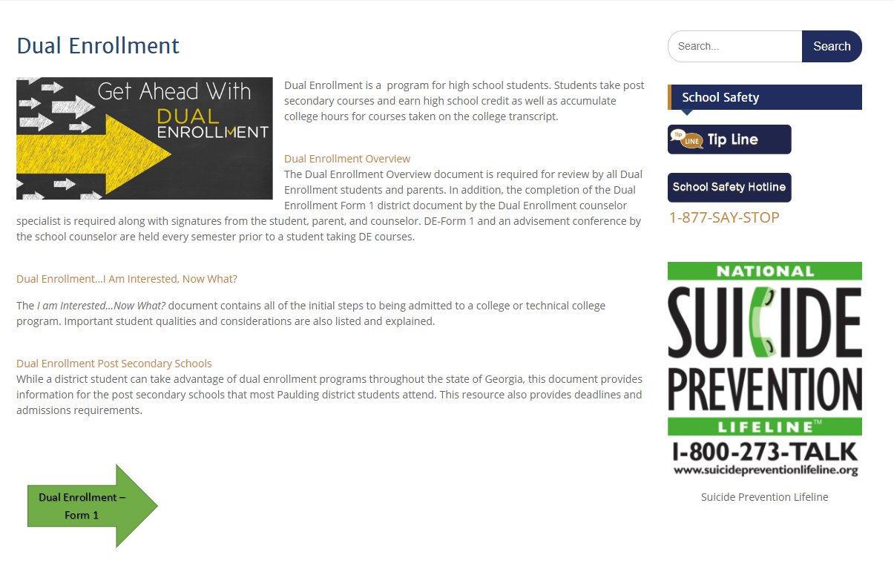
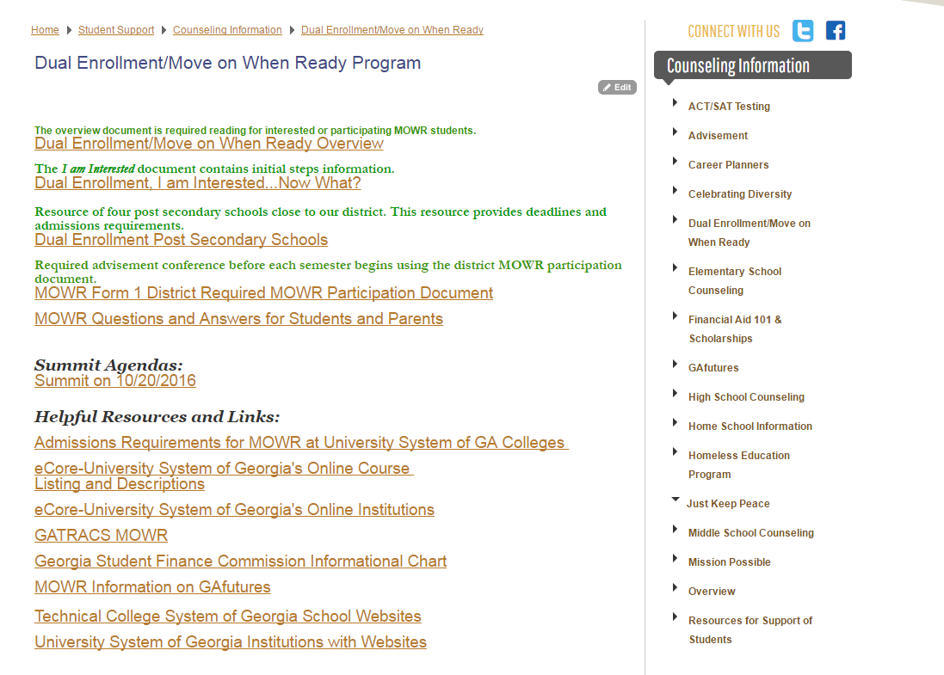
Information on the Paulding County Website:

Slide 61

Summit for Dual Enrollment Information for 2019-2020
Fall Summit
Spring Summit
September 10, 2019
LOCATION: Paulding County High School
TIME: 6:00 p.m.- 7:00pm
February 13, 2020
LOCATION: Hiram high School
TIME: 6:00 p.m.- 7:00pm

Slide 62

Interested students and parents Should always contact the school counselor.
There is a Dual Enrollment specialist/counselor at each high school.

Slide 63
End-of-Course Assessments
Counts 20% of the final grade for the course.
Areas Tested:
  Ninth Literature/Composition
  American Literature/Composition
  GSE Algebra I
  GSE Geometry
  Physical Science
  Biology
  United States History
  Economics

Slide 64
TEST-OUT OPPORTUNITIES
Qualified students may test-out in up to 3 EOC courses throughout high school and earn up to 3 high school credits on his/her high school transcript.
Specific information is provided each year by the district Director of Student Assessment who provides school counselors with this information.

Slide 65
TEST-OUT OPPORTUNITIES
Basic Requirements
1. Limit is 3 courses during high school with a cap of 3 credits earned.
2. PCSD Test-out Registration Opportunity in January with information available prior to registration opportunity. This is an Online registration opportunity on the district website.
3. Student cannot have started a course(s) that he/she is planning to test-out.
4. During January registration a payment of $50.00 must be made for each test. Students who score Distinguished will have this money reimbursed after scores come back during April.
5. During February a grade of B or higher will be validated. Also, during February a teacher recommendation regarding the test-out opportunity must be received by the school counselor. This recommendation is completed by the student’s teacher in the subject area.
6. EOCs taken during March.
7. For a student who receives a Distinguished score, the high school transcript is updated with course, grade/score and credit earned.

Slide 66
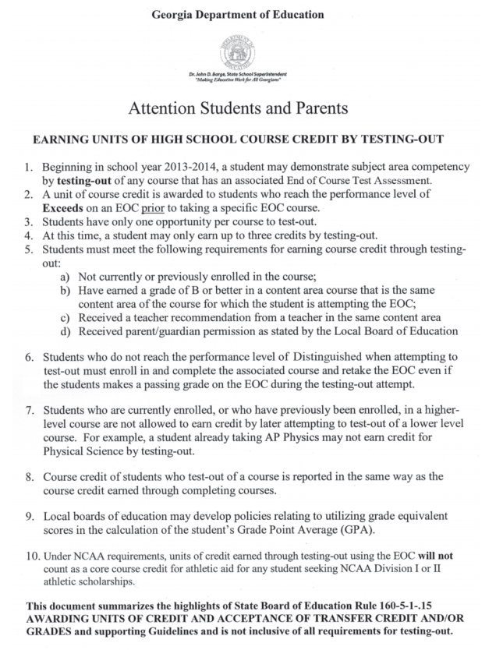
Test-out Opportunities Information from GADOE in Career Planner

Slide 67
PSAT
The Preliminary Scholastic Aptitude test provides a standardized view of a student’s scholastic skills, regardless of the school attended, and helps students compare themselves with other college-bound students nationwide.
This test is taken in October of your 10th grade year during the school day.

Slide 68
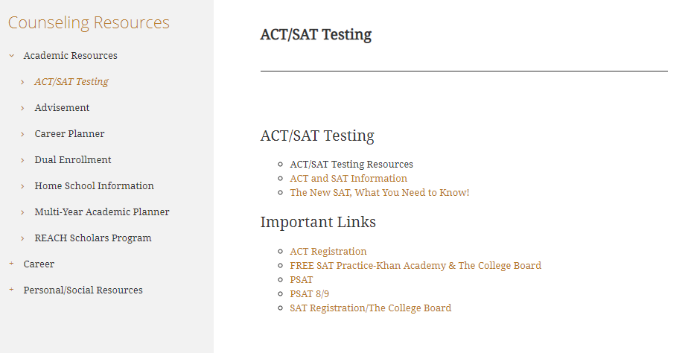
ACT and SAT
While the best SAT preparation is through rigorous and challenging course work in which the student puts forth maximum effort, students are strongly encouraged to go to www.GAcollege411.org to take advantage of two comprehensive resources for Georgia High School students to help them prepare for the SAT.

Slide 69
Work-Based Learning
A student may be eligible to participate in one of the Work-Based Learning Programs.
  Opportunities include:
    Youth Apprenticeship
    Cooperative Education
    Internship
    Employability Skills Development
These programs:
  Put book knowledge to use and gain hands on experience in your career.
  Earn school credit in your career area during your Junior and Senior year.
  Earn money while learning (excluding some internships).
Interested students should contact the school counselor for additional information.
Slide 37

Slide 70

The use of GAfutures and GCIS sites + School Counselors help students answer these 3 questions:
Who I am?
Where I am going?
How will I get there?

Slide 71
Our Counseling Program
Promotes development and support for EVERY student:
  Academic
    Rigorous courses
    Course completion
    Increased graduation rates
  Career
    Links to next step and eventually world of work
  Personal/social

